Slide 1
Aastha – an easy and powerful traffic generator
Publish date: June 2024
Domenico Dastoli

Slide 2
What is Aastha
Aastha is a tool developed by Cisco engineering from DCN BU.
Aastha is L2-L7 realistic traffic generator that supports HTTP(S), FTP(S), IMAP/POP3/SMTP protocols natively and any other through TRex integration. Generates up to 10000 virtual clients on a single node, supports distributed tests started simultaneously in different machines/VMs/places. Support IP pools, VLANs, QOS, Mac address generation.
Support using through simple intuitive Web UI, REST API, CLI tool, Python API. Web and PDF reports with charts and tables stored on the server.
trex-aastha@cisco.com is the internal contact

Slide 3
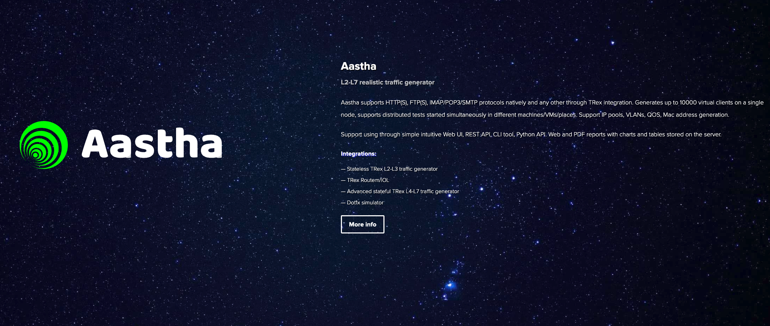
Where is it?
https://aastha.cisco.com/
No license is needed.

Slide 4
How to install
Images can be found here https://aastha.cisco.com:9005/aastha/release/latest/
Images are available for Windows, MacOS, Ubuntu, Docker. I have tested only Ubuntu.
You can run one node for the Web and API and one or more nodes for generating traffic agent.
You can also run a single node with both web and agent.
You can assign multiple interfaces to each node. Clients and servers can’t run on the same interface, so you either need two nodes (one for client one for server) or two interfaces (one for client, one for server).

Slide 5
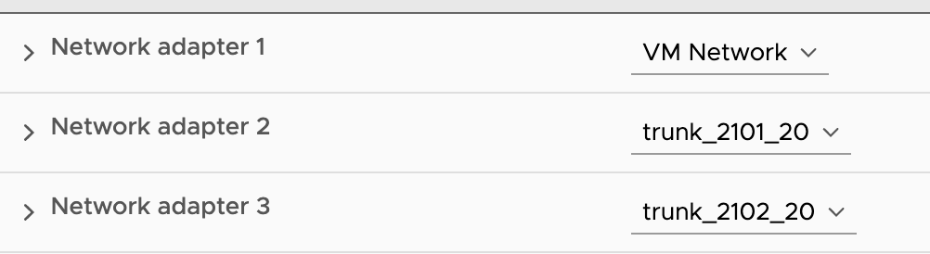
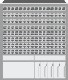
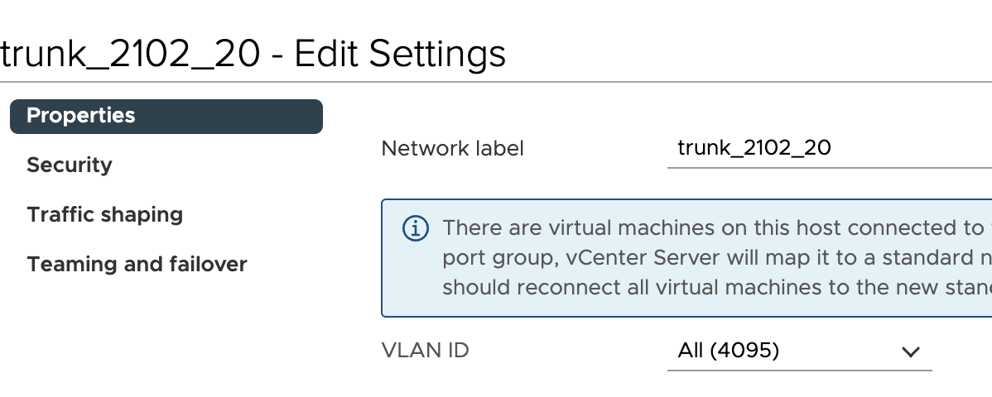
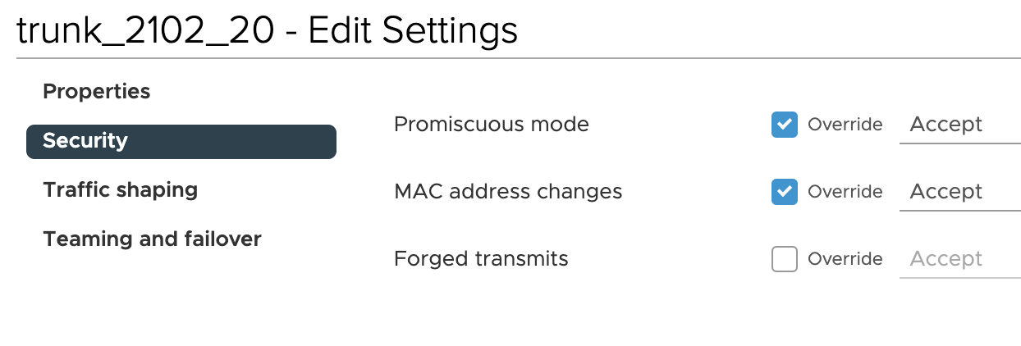
Basic Topology
One single VM with both web and agent.
3 Port groups, one for mgmt OOB
2 ports should be trunk promiscous for generating dot1q tagged traffic
eth1/20
eth1/20
vNIC2
ens192
vNIC3
ens224
vNIC1
ens160
OOB

Slide 6
Ubuntu Installation
Ubuntu 20.04 at least 24GB RAM, 4vCPUs, 20GB HDD (this is what I have tested in the lab, but Aastha does not expose any specific requirements)
Download https://aastha.cisco.com:9005/aastha/release/latest/focal/aastha-bundle.tar.gz and untar
Install as a service ./aastha-services
Install npm
Install
npm install mime-types
npm install debug
You may have to copy /node_modules to /opt/aastha/

Slide 7
Start the service
On the web node you should start the web service:
service aastha-web start
On the agent node you should start the node service:
service aastha-agent start

Slide 8
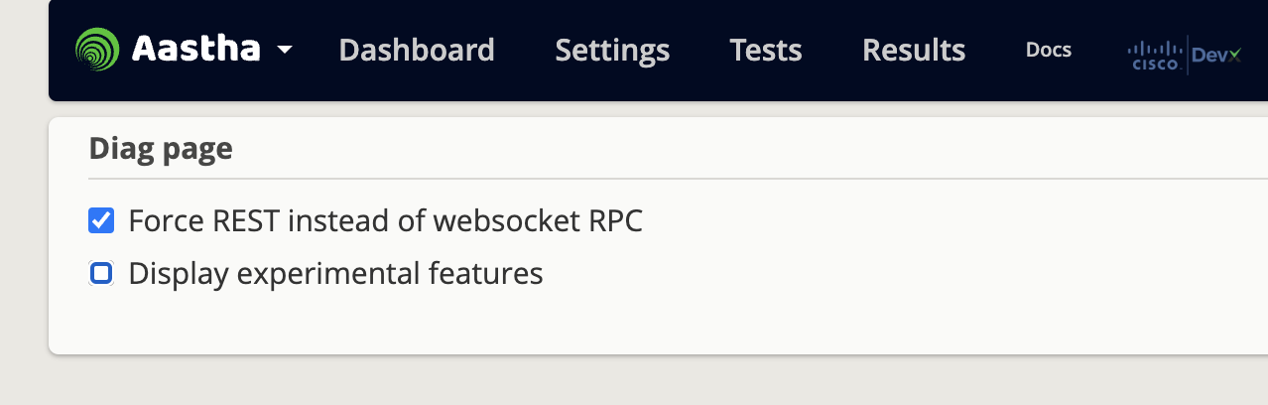
Access web UI
Once web service runs, it opens portal on port 80 (make sure it is free)
So just login to http://<aastha_web_IP>
Enable API by accessing http://<aastha_web_IP>/diag and selecting Force REST option
From now you can inspect the API with browser

Slide 9
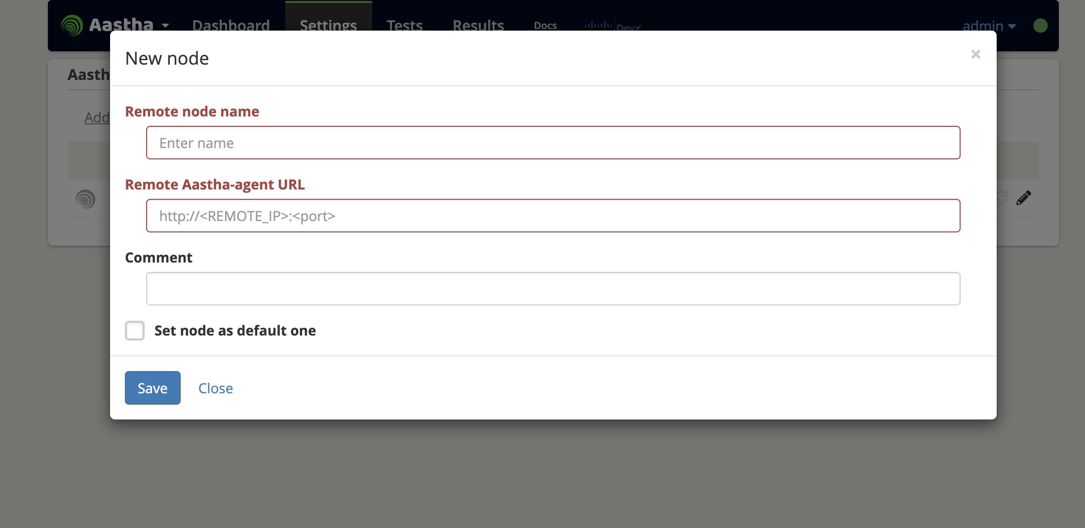
Add nodes
Simply go to Settings -> Add node
Insert the node name and the URL of the node with port 8888 (that’s the default agent port)

Slide 10
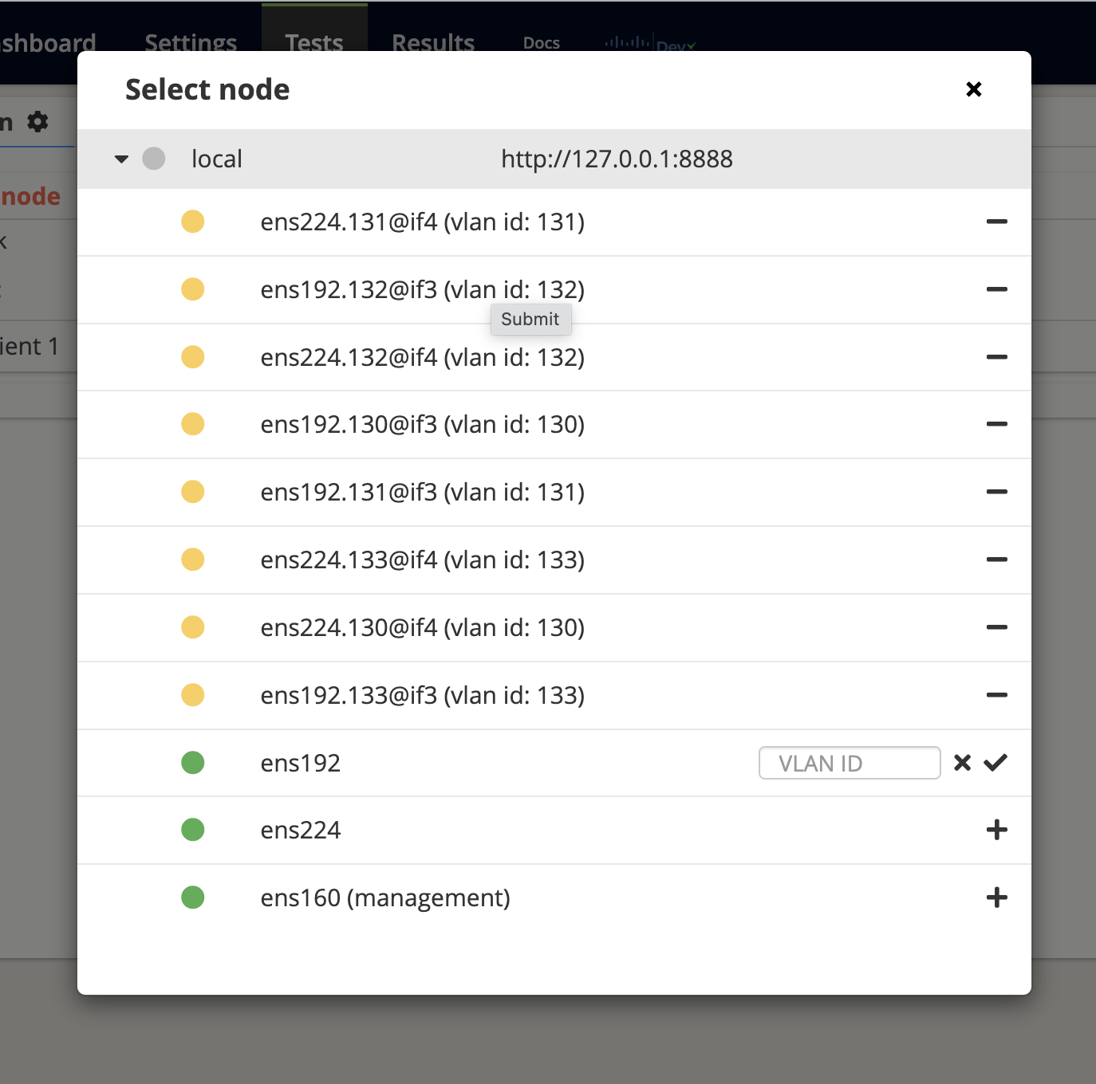
Create node sub interfaces
Go to Tests, click on select node, choose the node where to add sub interfaces click on the + next to the interface and specify the VLAN.

Slide 11
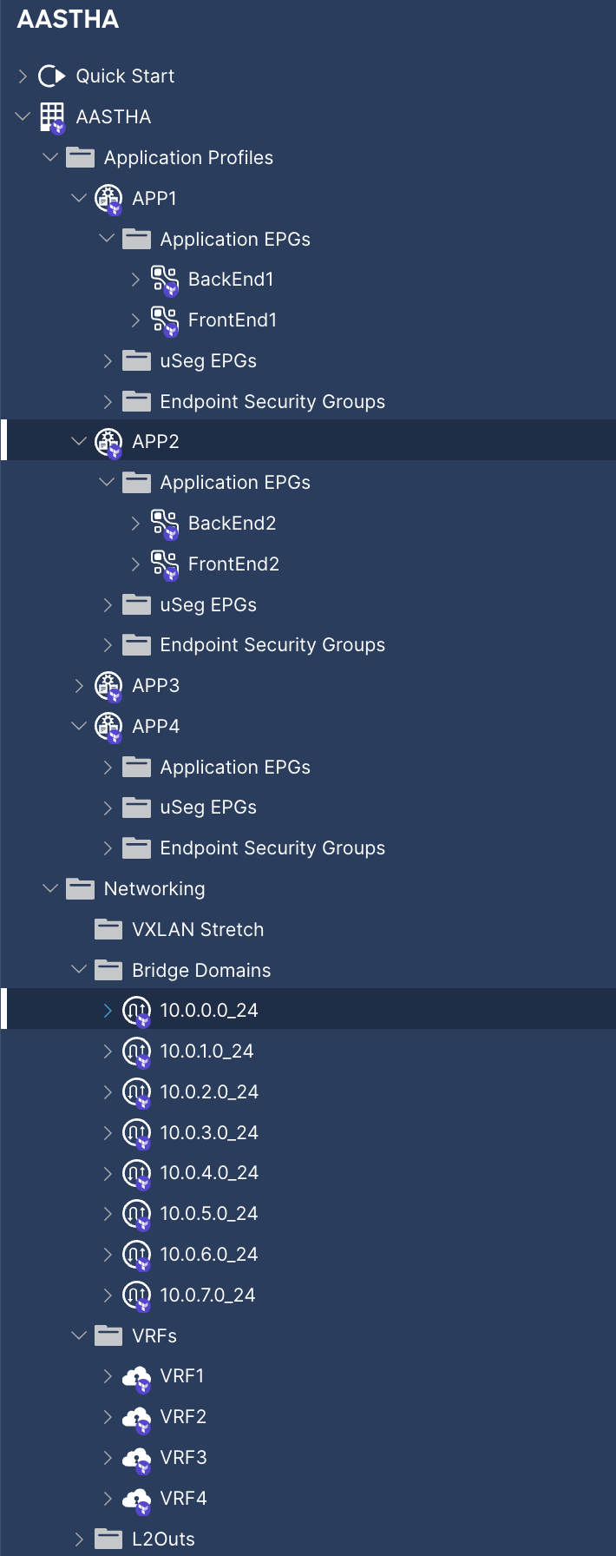
Configure the fabric
Prepare your fabric to host traffic. If it’s ACI obviously configure the right VLAN pool, physDom etc for access policy
Create the EPGs where to fit the clients and servers.
An example of Tenant with 4 apps with FE and BE is here and using Nexus as a Code: https://github.com/ddastoli/aastha_poc/blob/main/tenant_AASTHA.nac.yaml

Slide 12
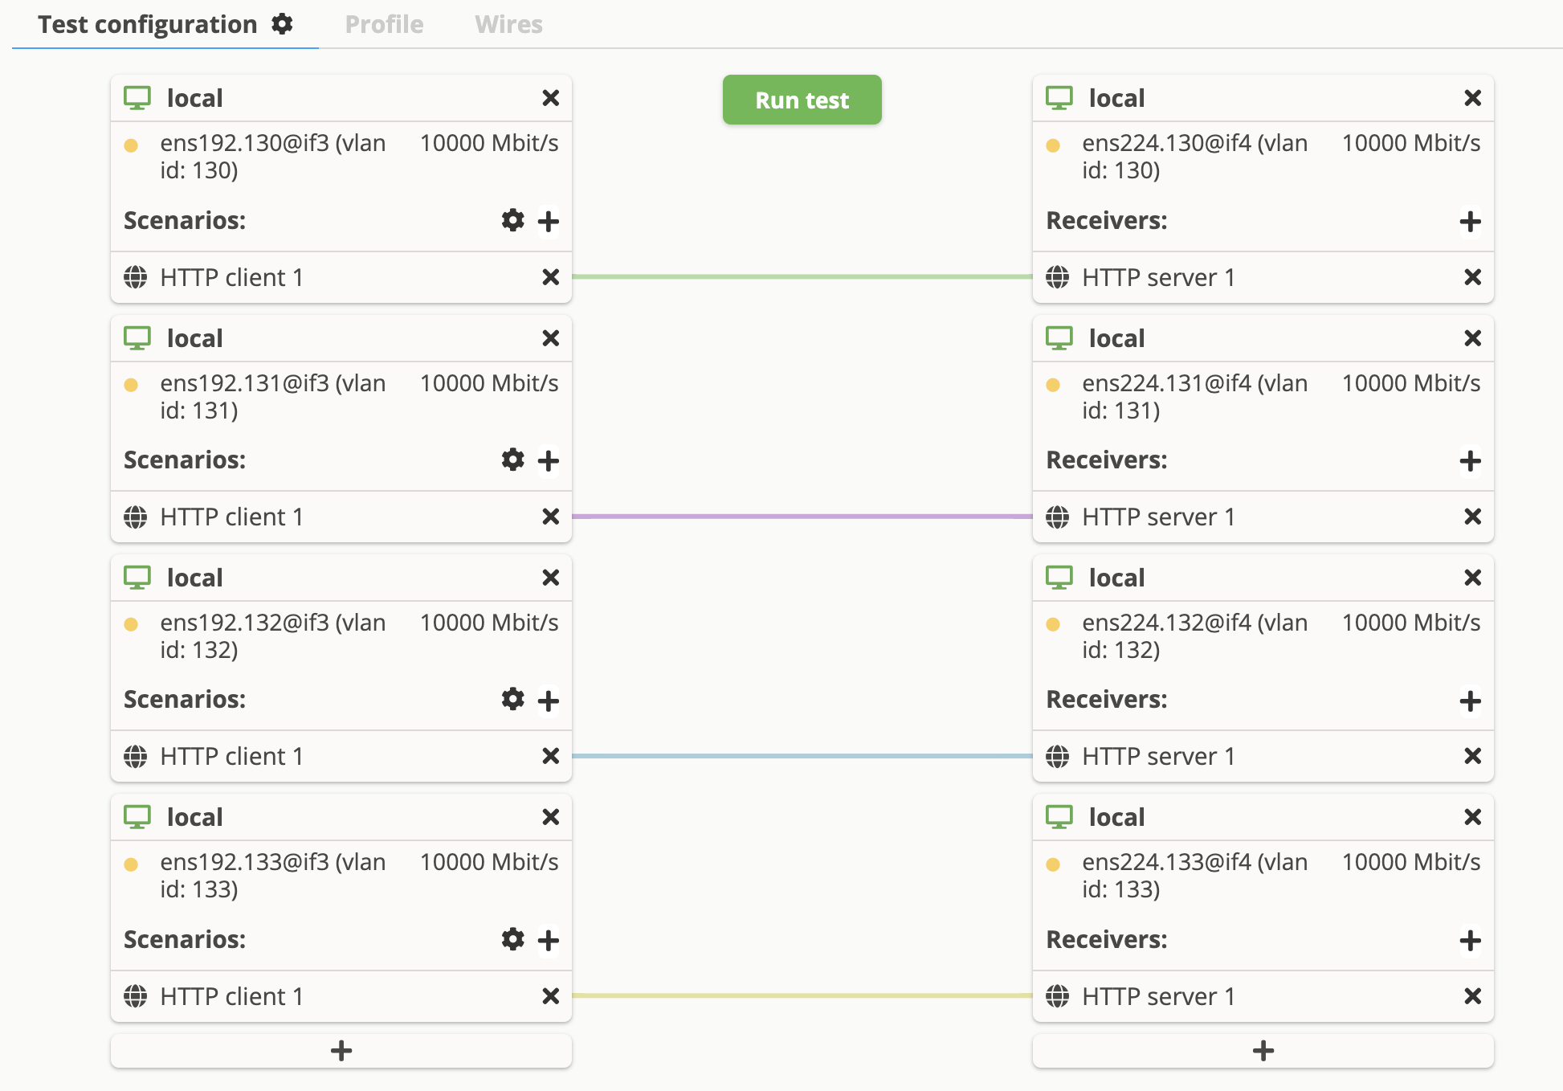
Create Test Traffic
From Tests you can configure the traffic generator.
On the left you configure the node for client configuration, on the right it is the server.
You can choose how many clients are created (range), what port they use and protocol to test. Many other options are available, i.e. duration, IPv6, L7, QoS. For more options TReX agents shall be used.

Slide 13
Some test configuration with API
I have prepared a collection for PostMan here https://github.com/ddastoli/aastha_poc/blob/main/Aastha_Create_Traffic.postman_collection.json you can import to check API to generate 4 sets of clients sending HTTP request on 4 servers running on different TCP ports. Each apps runs on different pairs of VLAN, subnets etc.
This can be used just as an example.

Slide 14
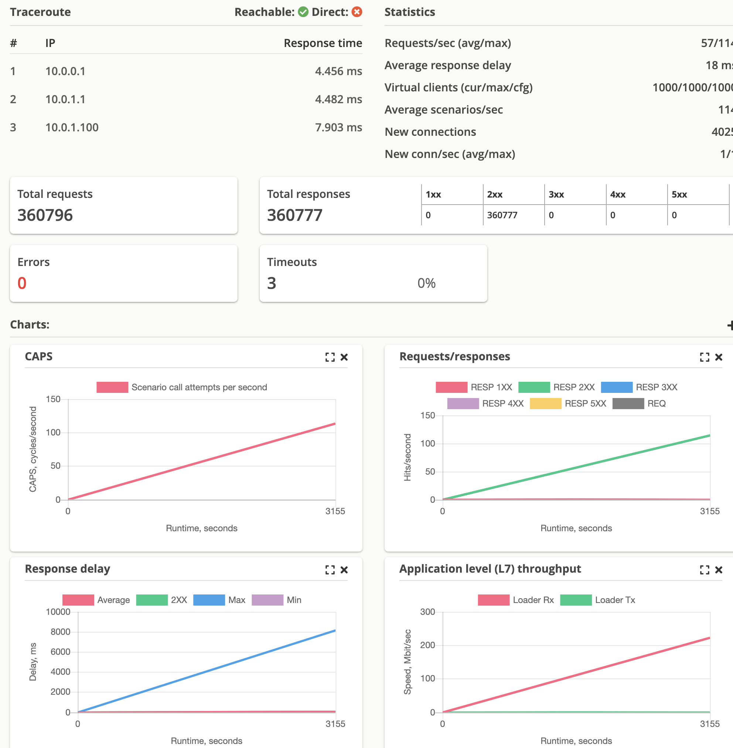
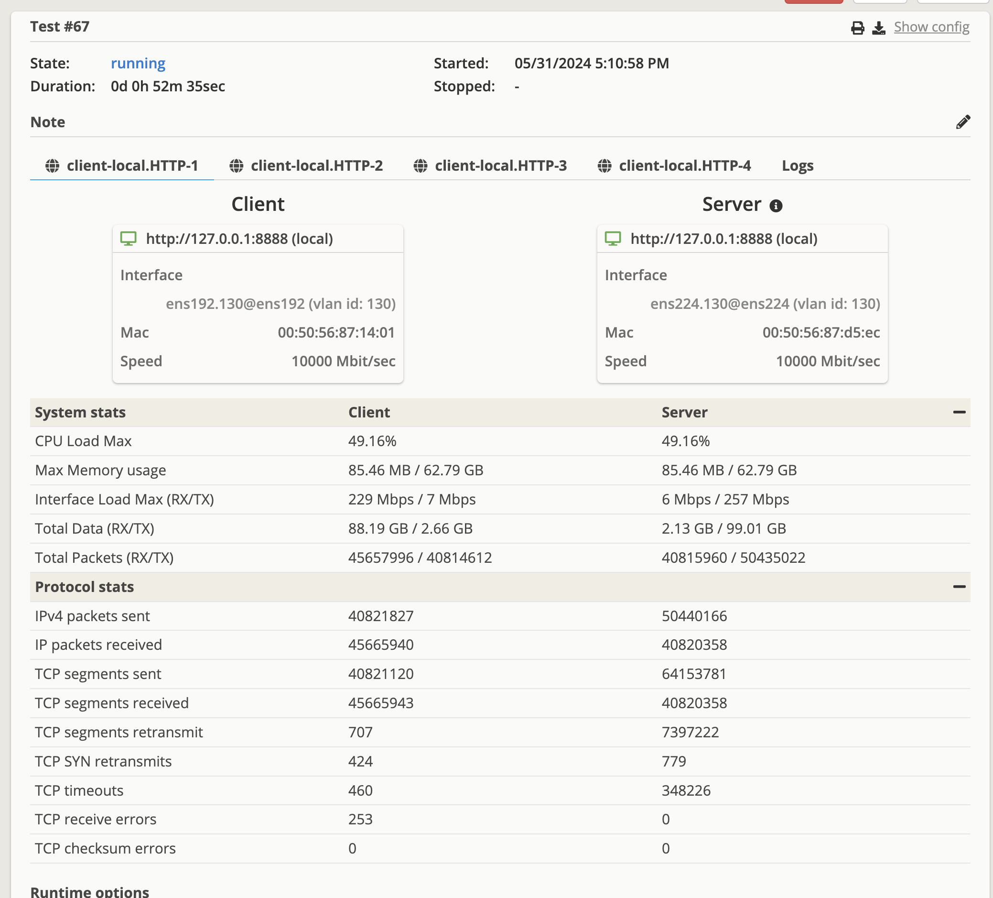
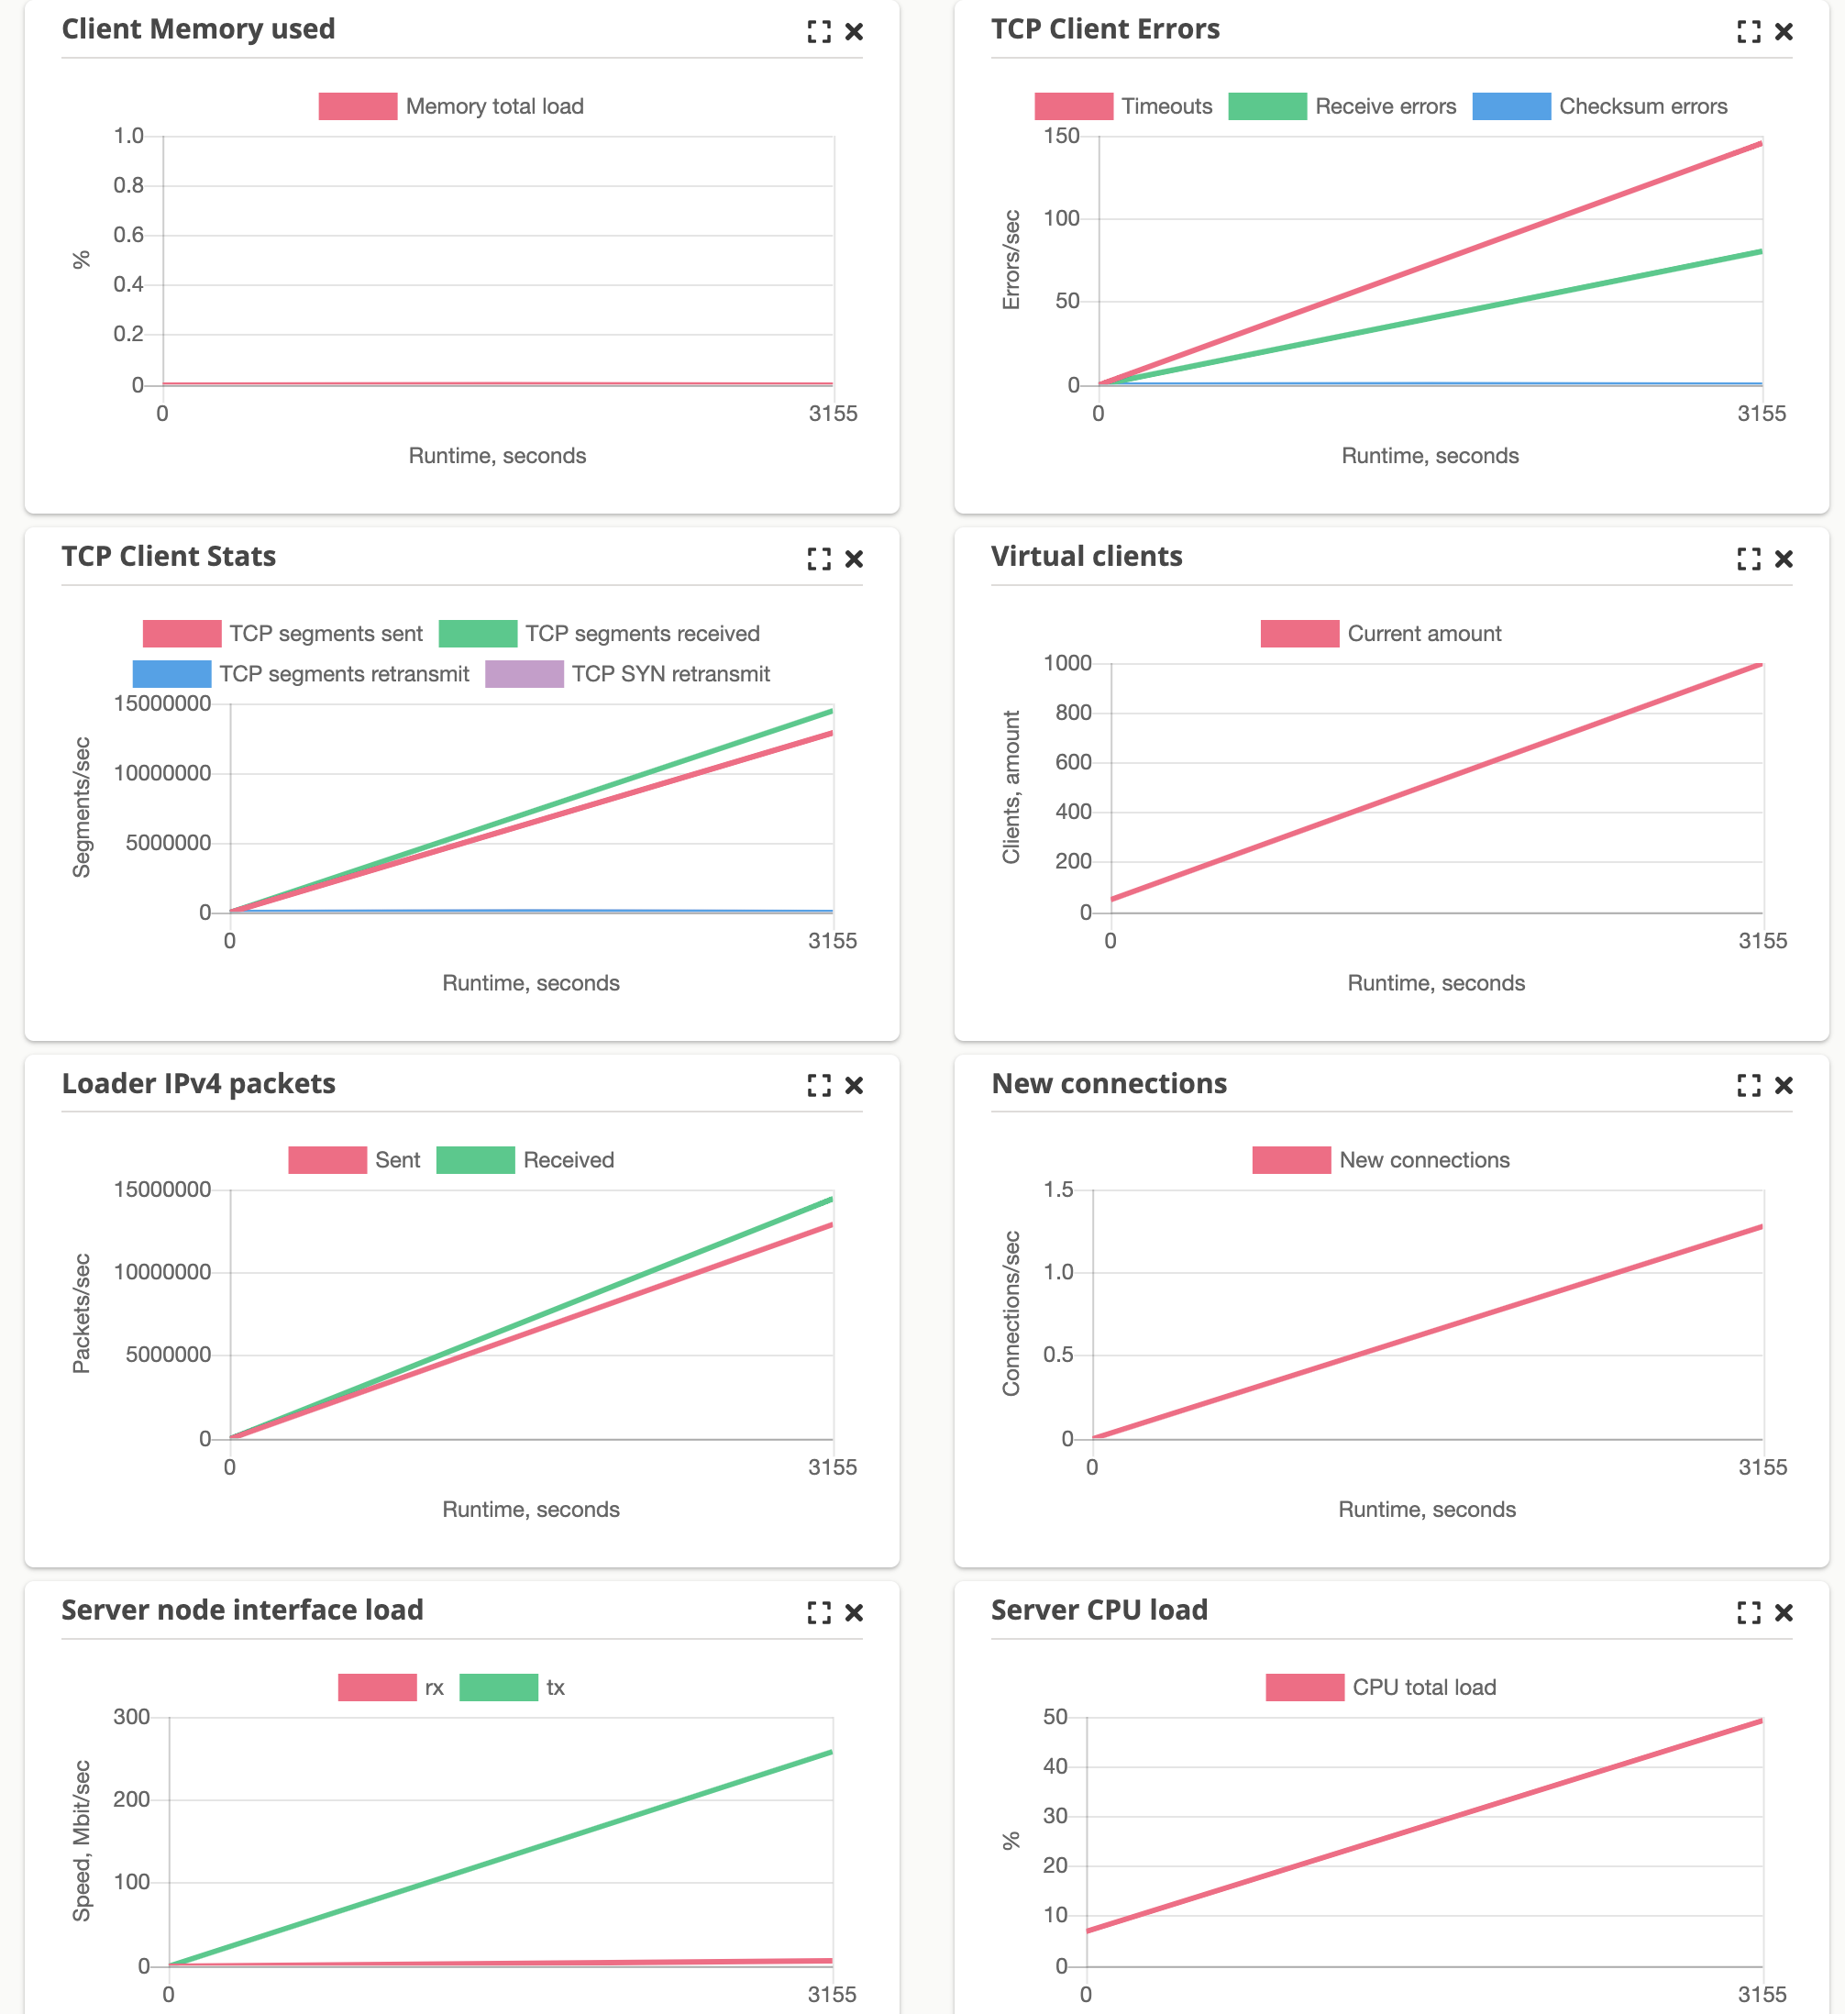
Run the test
The test provides much details of the client-server connectivity.

Slide 15
Summary
Aastha is a nice free alternative to expensive tools like Spirent, Ixia.
Certainly the support and flexibility may not be at the same level, but for many scenarios it does its job well.
It is easy to setup, support (although API are not documented) automation and it is quite powerful with limited VM resources.

